Slide 1
Bengali Text Classification Using Hybrid Model
Presented by
Name: Arabinda Das
Exam Roll: MCA2340031
Project Supervisor: Prof. Kamal Sarkar

Slide 2
CONTENT
Introduction
Proposed Methodology
Experiment
Evaluation And Result
Conclusion
Future Work

Slide 3
INTRODUCTION
Bengali text classification
It is the method of allocating Bengali text documents to predefined labels according to their content of traits
It automatically classify Bengali text into several groups or classes using machine learning algorithms and natural language processing (NLP) approaches.

Slide 4
INTRODUCTION
Latent Semantic Indexing
It is a technique used in natural language processing and information retrieval to analyze and retrieve information based on the underlying semantic relationships between words.
The LSI based document indexing has two important steps:
computing the Term-Document matrix, where rows represent terms (words) and columns represent documents,
applying SVD on the Matrix.

Slide 5
INTRODUCTION
Word embedding based model
is a type of natural language processing (NLP) model that represents words as dense numerical vectors in a high-dimensional space.
The word embedding based model has two important steps:
Generate the document embedding from pretrained word2vec model of word embedding
Document by term representation

Slide 6
PROPOSED METHODOLOGY
Collect and preprocess the Bengali text data.
Creating Term by Document matrix using Tf-Idf
Document by concept/term matrix
Apply Singular value decomposition (Reducing Dimensionality)
Collect and preprocess the Bengali text data
Tokenize the documents
Document by term matrix
Generate the document embedding from pretrained word2vec model of word embedding
Concatenation
Classifier

Slide 7
Collect and Preprocess the Bengali text data
Bengali Text: "আমি আজ অফিসে যেতে পারবো না কারণ আমি বাইরে আছি।"
Removing punctuation marks: Replace punctuation marks with blank spaces.
"আমি আজ অফিসে যেতে পারবো না কারণ আমি বাইরে আছি "
Tokenization: Split the sentence into individual words or tokens.
["আমি", "আজ", "অফিসে", "যেতে", "পারবো", "না", "কারণ", "আমি", "বাইরে", "আছি"]
Removing Stop words: Stopwords like আমি, আজ, না, আছি, উনি, ইত্যাদি, etc are removed.
["অফিসে", "যেতে", "পারবো", "কারণ", "বাইরে"]
Stemming: Reduce each word to its base form by removing common suffixes.
["অফিস", "যেত", "পার", "কারণ", "বাইর"]

Slide 8
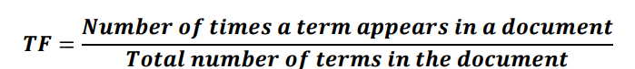

Creating Term by Document Matrix
The pre-processed Bengali text data is converted into Term by document Matrix by using the TF-IDF (Term Frequency-Inverse Document Frequency) vectorization technique.
Term Frequency (TF): The frequency of a term (word) within a document or a collection of documents.
Inverse Document Frequency (IDF): It is used to measure the significance of a term within a collection of documents.

Slide 9
Creating Term by Document Matrix
TF-IDF: It is a numerical representation used to evaluate the importance of a term within a document in the context of a collection of documents.
TF-IDF (t, d) = TF (t, d) * IDF (t)
Where TF-IDF (t, d) represents the TF-IDF weight of the term t corresponding to document d, TF (t, d) represents the term frequency of the term t corresponding to document d, IDF(t) represents the IDF value of the term t.
Document Representation:
In this Matrix each row corresponds to a term and each column corresponds to a document.
The cell_{(i,j)} of the matrix contains TF-IDF weight of i^{th} word occurring in j^{th} document.
A Column of the matrix is vector representation for a document.

Slide 10
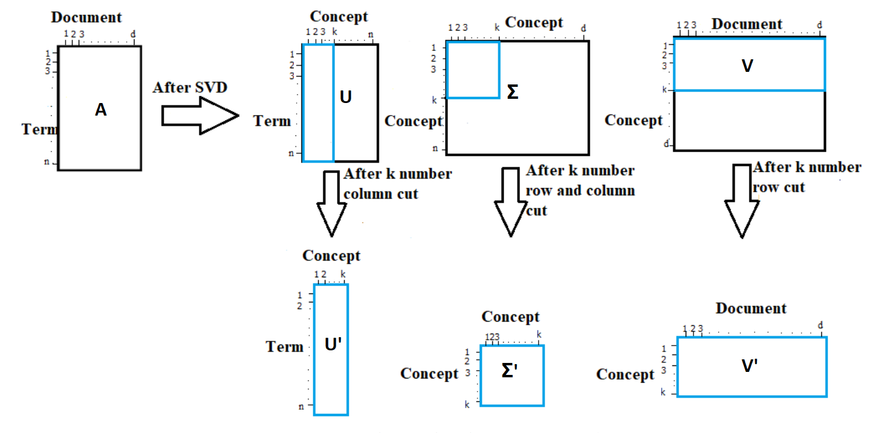
SVD (Singular Value Decomposition)
SVD is applied to the Term by Document Matrix.
It is a technique used for dimensionality reduction in the text data.
Application of SVD on a matrix A results in three different matrices U, Σ and V as follows:
𝑨_{𝒏∗𝒅} = 𝑼_{𝒏∗𝒏} ∗ 𝚺_{𝒏∗𝒅} ∗ 𝑽_{𝒅∗𝒅}
From the NLP point of view, U is term by concept matrix, Σ is concept by concept diagonal matrix and V is a concept by document matrix[1].
A row of the reduced matrix V' = {𝑉_{𝑖𝑗}}, i=1 to k and j= 1 to d, is indexed by a significant abstract concept, and 𝑉_{𝑖𝑗} represents how much the document j is similar with the i-th concept.
Transposing V', we obtain (V')^{T} which is a document-by-concept matrix whose rows are the representations of the documents in the latent semantic space. This (V’)^{T} is applied in a classifier.

Slide 11
WORD EMBEDDING BASED (WORD TO VEC) MODEL
After removing stop words, we get meaningful words for each document. For each word, we search for the corresponding word vector into the list of word vectors obtained from a Bengali pretrained word vector model called Fast Text. Then we calculate the average of the vectors for the words. Thus each document is represented as a vector.
Dimension of the Document by term matrix:
1756(No. of Document present in the dataset) * 300(Dimension of the pretrained word2vec model).

Slide 12
CONCATENATION OF SVD WITH THE WORD EMBEDDING BASED MODEL
Finally, to concatenate the two matrices, we perform element-wise addition. This means that we add the corresponding elements of the document-by-concept matrix (from SVD) to the corresponding elements of the document-by-term matrix (from word embeddings).
By combining these two matrices through addition, we create a unified and enriched representation of each document. This representation incorporates both the semantic concepts captured by LSI and the contextual meaning encoded in the word embeddings. The combined matrix allows us to leverage the strengths of both techniques and provides a more informative and expressive document representation for various downstream tasks.
Dimension of the resulting Document by term matrix:
1756(No. of Document present in the dataset) * 300(Dimension of the pretrained word2vec model).

Slide 13
CLASSIFIER
Support Vector Machines (SVM)
SVM is a classifier that is renowned for its efficiency in processing high dimensional data and its capacity to identify the best decision boundaries to separate different classes of documents.
Once we have transformed the documents into the Document by Concept Matrix, we can use an SVM classifier to train and classify the documents.
Split our data into training and test sets. Train the SVM classifier on the training set.
SVM can handle both linear and non-linear classification tasks through the use of kernel functions[2].
Optimize the LSI model by tuning the hyperparameters such as the number of dimensions while using SVM Classifier.
Evaluate its performance on the test set using appropriate evaluation metrics such as accuracy, precision, recall, or F1-score.

Slide 14
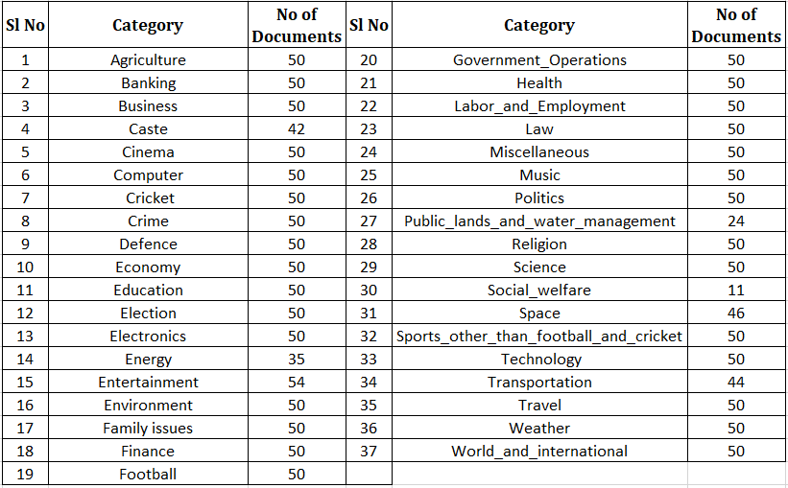
EXPERIMENT
We have gathered a large dataset of Bengali text documents amounting to 1756 which belongs to 37 Categories.

Slide 15
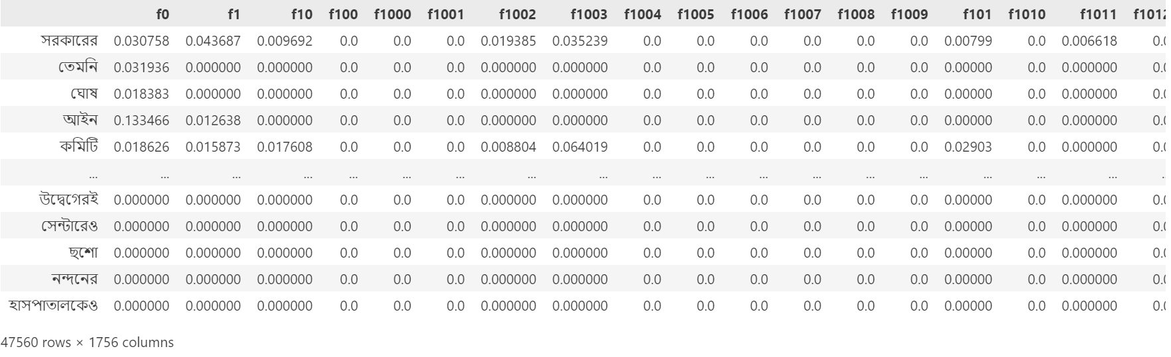
Term by Document Representation after applying Tf-Idf
After preprocessing all the Bengali text in 1756 documents, we get total of 47560 terms and calculating the TF-IDF weight of each term belonging to those documents is represented as Term by Document Matrix.

Slide 16
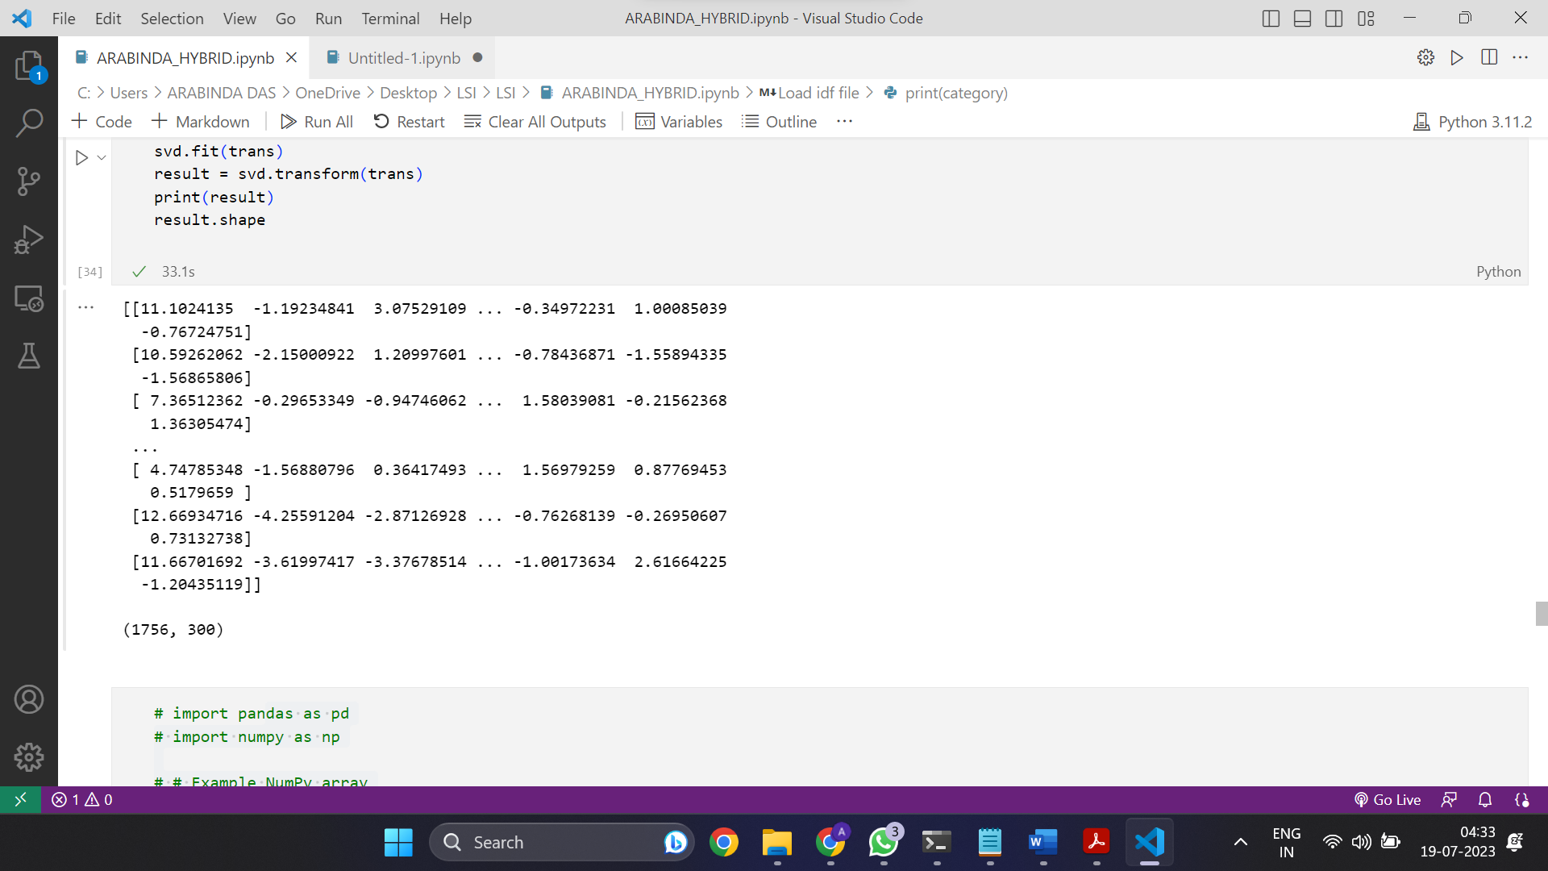
Document by Concept Representation From SVD
SVD applying to the Term by Document gives three matrices U, Σ and V(Concept by Document Matrix) which varies depending on the ‘n_components’ parameter in the SVD class. Concept by Document Matrix is then transposed making it Document by Concept Matrix which is used for Classification.

Slide 17
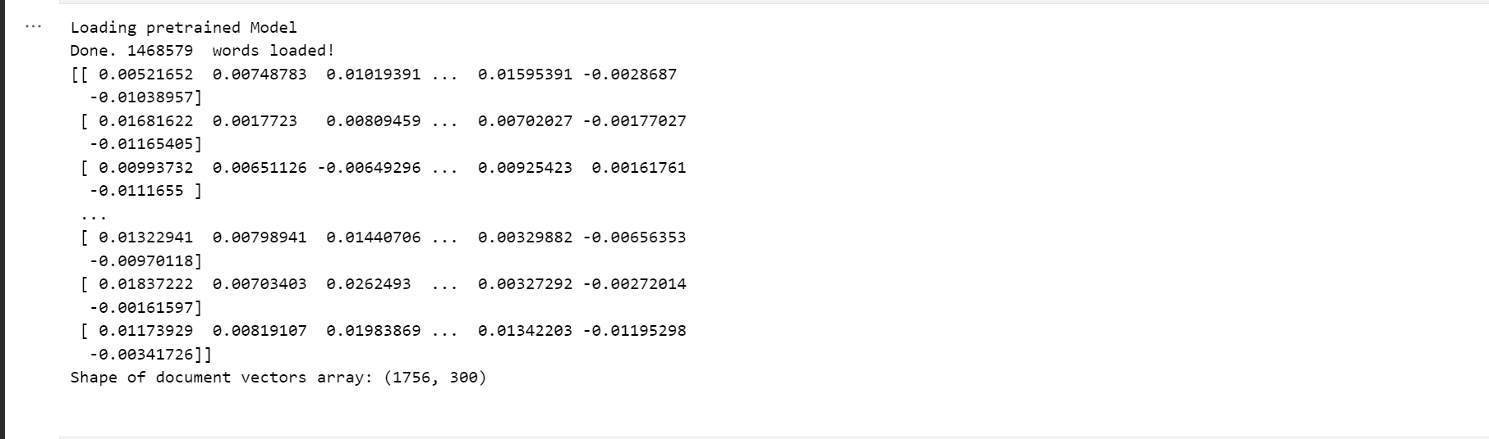
Document by Term Representation From Word Embedding
Utilizing a pre-trained word-to-vector model, we generate document vectors that represent the semantic meaning of each document. These document vectors are organized into a document-by-term matrix, similar to the one obtained from the SVD approach, with dimensions 1756 (number of documents) x 300

Slide 18
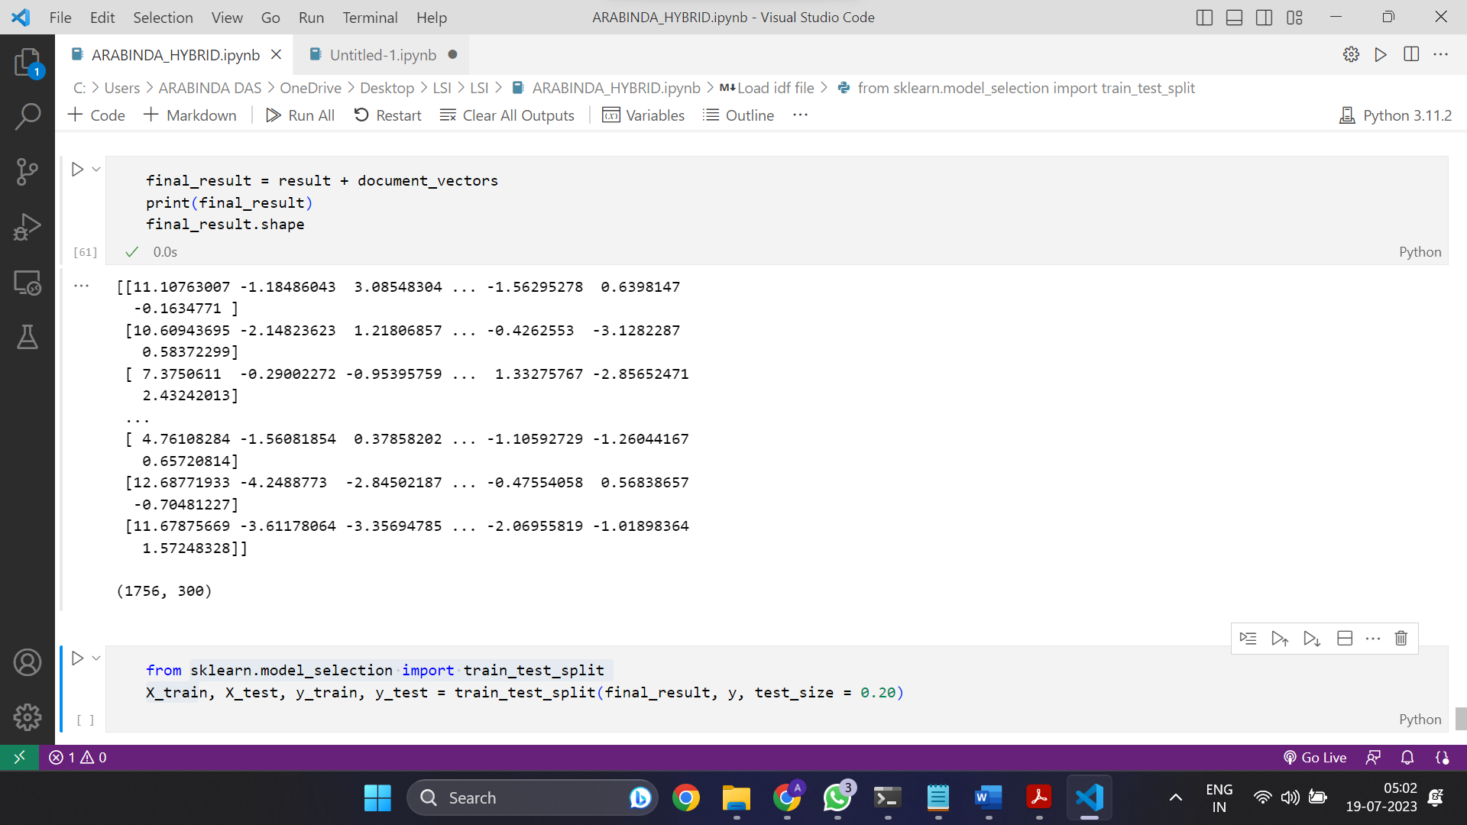
Document by Term Representation after Concatenation
The combined document-by-term matrix is a novel representation that emerges from the fusion of two distinct approaches: Latent Semantic Indexing (LSI) and word embeddings. This matrix captures both the underlying semantic structure of the document collection through LSI and the semantic meaning of individual documents through word embeddings. By combining these two sources of information, it offers a more comprehensive and enriched representation for each document.

Slide 19
Parameter Tuning
Optimize the models by tuning the parameters such as the number of dimensions or concepts of Document by Concept Matrix before using SVM Classifier.
We split this Document by Concept/term Matrix into the training and test set. 20% of it is kept as the test set and remaining 80% used for training the model of SVM classifier.
The kernel used here is ‘rbf’ kernel which stands for Radial Basis Function.
We tune gamma and C parameters of SVM to get more optimal results.
Evaluate its performance on the test set using appropriate evaluation metric such as accuracy.
Accuracy represents the number of correctly classified data instances over the total number of data instances. Higher accuracy values indicate a more successful classification model.

Slide 20
Tuning gamma and C parameters
Gamma Parameter
The gamma parameter controls the influence of each training example.
Lower values of gamma result in a larger influence radius, making the decision boundary smoother.
Higher values of gamma make the influence radius smaller, leading to more complex and intricate decision boundaries.
C Parameter
The C parameter is the regularization parameter in SVM that controls the trade-off between achieving a low training error and a low testing error.
A smaller C value makes the decision boundary smoother and allows more margin violations.
A larger C value aims to classify all training examples correctly and may lead to a tighter decision boundary.

Slide 21
Tuning gamma and C parameters of LSI
gamma | C | Accuracy (%)
0.001 | 1 | 45
0.002 | 1 | 53
0.003 | 1 | 57
0.001 | 10 | 64.5
0.002 | 10 | 64.2
0.003 | 10 | 63
0.001 | 100 | 64
0.002 | 100 | 62
0.003 | 100 | 60
We got the highest Accuracy of 64.5 % for gamma=0.001 and C=10.

Slide 22
Tuning gamma and C parameters of word embedding
gamma | C | Accuracy (%)
0.001 | 1 | 59
0.002 | 1 | 60
0.003 | 1 | 63
0.001 | 10 | 65.9
0.002 | 10 | 62.5
0.003 | 10 | 60
0.001 | 100 | 66.19
0.002 | 100 | 65.34
0.003 | 100 | 65.9
We got the highest Accuracy of 66.19 % for gamma=0.001 and C=100.

Slide 23
Tuning gamma and C parameters of the concatenated Hybrid model
gamma | C | Accuracy (%)
0.001 | 1 | 48
0.002 | 1 | 51.13
0.003 | 1 | 53.12
0.001 | 10 | 65.34
0.002 | 10 | 58.23
0.003 | 10 | 61.36
0.001 | 100 | 61.93
0.002 | 100 | 59.94
0.003 | 100 | 59.09
We got the highest Accuracy of 65.34 % for gamma=0.001 and C=10.

Slide 24
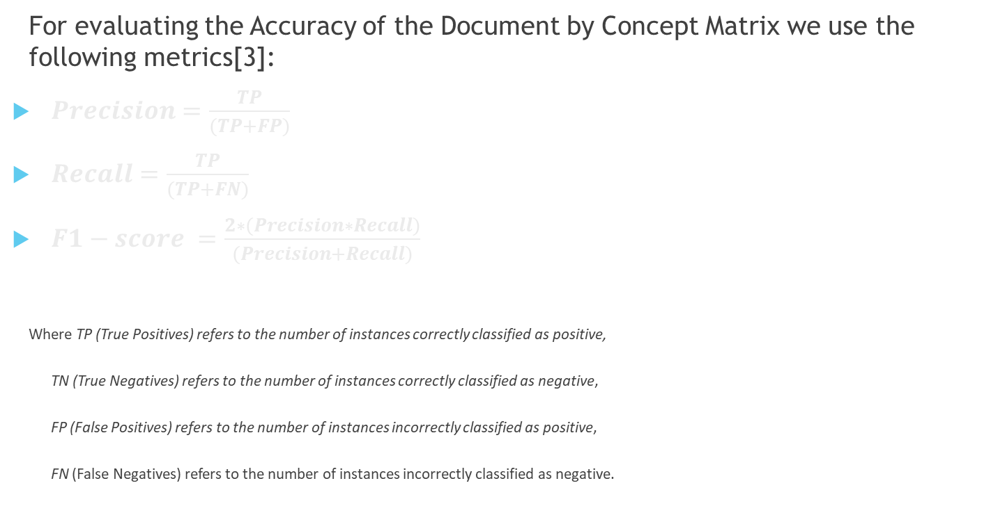
Evaluation and Results
For evaluating the Accuracy of the Document by Concept Matrix we use the following metrics[3]:
$Precision=\frac{TP}{(TP+FP)}$
$Recall=\frac{TP}{(TP+FN)}$
$F1−score =\frac{2∗(Precision∗Recall)}{(Precision+Recall)}$
Where TP (True Positives) refers to the number of instances correctly classified as positive,
TN (True Negatives) refers to the number of instances correctly classified as negative,
FP (False Positives) refers to the number of instances incorrectly classified as positive,
FN (False Negatives) refers to the number of instances incorrectly classified as negative.

Slide 25
Evaluating the Precision, Recall, F1-score, Support for LSI
class | precision | recall | f1-score | support
Agriculture | 1.00 | 0.44 | 0.62 | 9
Banking | 0. 50 | 0.70 | 0.58 | 10
Business | 0.44 | 0.40 | 0.42 | 10
Caste | 0.57 | 0.89 | 0.70 | 9
Cinema | 0.83 | 0.38 | 0.53 | 13
Computer | 0.60 | 0.75 | 0.67 | 12
Cricket | 0.88 | 0.88 | 0.88 | 16
Crime | 0.40 | 0.18 | 0.25 | 11
Defence | 1.00 | 0.88 | 0.93 | 8
Economy | 0.59 | 0.67 | 0.62 | 15
Education | 0.67 | 0.57 | 0.62 | 7
Electronics | 0.83 | 0.62 | 0.71 | 8
Energy | 0.75 | 0.86 | 0.80 | 7
Entertainment | 0.38 | 0.91 | 0.54 | 11
Environment | 0.67 | 1.00 | 0.80 | 6
Family issues | 0.57 | 0.33 | 0.42 | 12
Finance | 0.00 | 0.00 | 0.00 | 10
Football | 0.89 | 0.89 | 0.89 | 9
Government_Operations | 0.40 | 0.44 | 0.42 | 9
Health | 0.67 | 0.67 | 0.67 | 9
Labor_and_Employment | 0.64 | 0.82 | 0.72 | 11
Law | 0.64 | 0.47 | 0.54 | 15
Miscellaneous | 1.00 | 1.00 | 1.00 | 11
Music | 0.89 | 0.80 | 0.84 | 10
Politics | 0.75 | 0.67 | 0.71 | 9
Public_lands_and_water _management | 0.00 | 0.00 | 0.00 | 1
Religion | 0.80 | 1.00 | 0.89 | 8
Science | 0.35 | 0.89 | 0.50 | 9
Social_welfare | 0.00 | 0.00 | 0.00 | 3
Space | 0.89 | 1.00 | 0.94 | 8
Sports_other_than _football_and_cricket | 1.00 | 1.00 | 1.00 | 7
Technology | 1.00 | 0.11 | 0.20 | 9
Transportation | 0.75 | 0.55 | 0.63 | 11
Travel | 0.50 | 0.67 | 0.57 | 9
Weather | 1.00 | 0.85 | 0.92 | 13
World_and_International | 0.38 | 0.30 | 0.33 | 10
election | 0.83 | 0.71 | 0.77 | 7
accuracy |  |  | 0.64 | 352
macro avg | 0.65 | 0.63 | 0.61 | 352
weighted avg | 0.67 | 0.64 | 0.63 | 352
Accuracy: 0.645

Slide 26
Evaluating the Precision, Recall, F1-score, Support for word embedding
Accuracy: 0.6619
class | precision | recall | f1-score | support
Agriculture | 0.70 | 0.78 | 0.74 | 9
Banking | 0.47 | 0.80 | 0.59 | 10
Business | 0.42 | 0.50 | 0.45 | 10
Caste | 0.25 | 0.40 | 0.31 | 5
Cinema | 0.83 | 0.77 | 0.80 | 13
Computer | 0.60 | 0.50 | 0.55 | 6
Cricket | 0.69 | 1.00 | 0.82 | 9
Crime | 0.57 | 0.80 | 0.67 | 5
Defence | 0.82 | 0.64 | 0.72 | 14
Economy | 0.73 | 0.79 | 0.76 | 14
Education | 0.67 | 1.00 | 0.80 | 6
Electronics | 0.69 | 0.90 | 0.78 | 10
Energy | 1.00 | 0.50 | 0.67 | 6
Entertainment | 0.62 | 0.62 | 0.62 | 8
Environment | 0.70 | 0.88 | 0.78 | 8
Family issues | 0.55 | 0.60 | 0.57 | 10
Finance | 0.25 | 0.27 | 0.26 | 11
Football | 1.00 | 0.94 | 0.97 | 16
Government_Operations | 0.25 | 0.13 | 0.17 | 15
Health | 0.79 | 0.79 | 0.79 | 14
Labor_and_Employment | 0.33 | 0.17 | 0.22 | 6
Law | 0.67 | 0.60 | 0.63 | 10
Miscellaneous | 1.00 | 1.00 | 1.00 | 10
Music | 0.77 | 1.00 | 0.87 | 10
Politics | 0.67 | 0.50 | 0.57 | 8
Public_lands_and_water _management | 0.67 | 0.50 | 0.57 | 8
Religion | 0.58 | 0.70 | 0.64 | 10
Science | 0.62 | 0.62 | 0.62 | 8
Social_welfare | 0.00 | 0.00 | 0.00 | 2
Space | 0.83 | 0.91 | 0.87 | 11
Sports_other_than _football_and_cricket | 0.80 | 0.89 | 0.84 | 9
Technology | 0.60 | 0.43 | 0.50 | 7
Transportation | 0.67 | 1.00 | 0.80 | 6
Travel | 0.50 | 0.38 | 0.43 | 13
Weather | 0.91 | 0.91 | 0.91 | 11
World_and_International | 0.29 | 0.18 | 0.22 | 11
election | 0.88 | 0.54 | 0.67 | 13
accuracy |  |  | 0.66 | 352
macro avg | 0.63 | 0.65 | 0.63 | 352
weighted avg | 0.66 | 0.66 | 0.65 | 352
Accuracy: 0.6619

Slide 27
Evaluating the Precision, Recall, F1-score, Support for Hybrid model
Accuracy: 0.653409
class | precision | recall | f1-score | support
Agriculture | 1.00 | 0.55 | 0.71 | 11
Banking | 0.71 | 0.62 | 0.67 | 16
Business | 0.33 | 0.57 | 0.42 | 7
Caste | 0.71 | 1.00 | 0.83 | 5
Cinema | 0.86 | 0.35 | 0.50 | 17
Computer | 0.28 | 0.71 | 0.40 | 7
Cricket | 0.71 | 0.83 | 0.77 | 6
Crime | 0.83 | 0.62 | 0.71 | 8
Defence | 0.92 | 0.79 | 0.85 | 14
Economy | 0.81 | 0.93 | 0.87 | 14
Education | 0.69 | 0.75 | 0.72 | 12
Electronics | 0.91 | 0.71 | 0.80 | 14
Energy | 1.00 | 0.71 | 0.83 | 7
Entertainment | 0.32 | 0.79 | 0.46 | 14
Environment | 0.62 | 0.71 | 0.67 | 7
Family issues | 0.71 | 0.71 | 0.71 | 7
Finance | 0.44 | 0.31 | 0.36 | 13
Football | 1.00 | 0.70 | 0.82 | 10
Government_Operations | 0.38 | 0.38 | 0.38 | 8
Health | 0.71 | 0.50 | 0.59 | 10
Labor_and_Employment | 0.43 | 0.60 | 0.50 | 10
Law | 0.86 | 0.55 | 0.67 | 11
Miscellaneous | 0.75 | 0.86 | 0.80 | 7
Music | 1.00 | 0.89 | 0.94 | 9
Politics | 0.44 | 0.67 | 0.53 | 6
Public_lands_and_water _management | 0.80 | 0.80 | 0.89 | 5
Religion | 1.00 | 0.71 | 0.70 | 8
Science | 0.67 | 0.67 | 0.67 | 15
Social_welfare | 0.60 | 0.00 | 0.00 | 2
Space | 0.25 | 1.00 | 0.89 | 8
Sports_other_than _football_and_cricket | 1.00 | 0.80 | 0.47 | 5
Technology | 0.80 | 0.36 | 0.33 | 9
Transportation | 0.67 | 0.23 | 0.27 | 12
Travel | 0.60 | 0.29 | 1.00 | 7
Weather | 0.25 | 1.00 | 0.38 | 11
World_and_International | 1.00 | 0.33 | 0.38 | 13
election | 0.44 | 0.27 | 0.88 | 7
accuracy |  |  | 0.65 | 352
macro avg | 0.68 | 0.65 | 0.64 | 352
weighted avg | 0.70 | 0.64 | 0.64 | 352
Accuracy: 0.653409

Slide 28
CONCLUSION
Hybrid model combines LSI and word embedding.
Enhanced accuracy in categorizing text documents.
Demonstrated better results than individual approaches.
Enriched feature representation for comprehensive understanding.
Bridges semantic gap between word and document context.
Benefits applications like sentiment analysis and topic classification.
Ongoing research for domain adaptation and ensemble methods.
Focus on improving model interpretability.
Positive outlook for impactful text classification advancements.

Slide 29
Future Work
The future work for Bengali text classification using the hybrid model includes several avenues for improvement and exploration:
1. Data Augmentation: Due to limited labeled data, data augmentation techniques can be employed to artificially increase the size of the training set. Techniques such as back-translation, synonym replacement, and paraphrasing can be applied to generate additional training samples.
2. Domain Adaptation: Fine-tuning the hybrid model for specific domains or industries can enhance classification performance. By utilizing domain-specific data and incorporating domain-specific vocabulary, the model can adapt better to the target domain's language nuances.
3. Ensemble Methods: Creating an ensemble of multiple hybrid models, each trained with different architectures or parameters, can improve overall classification accuracy. By combining the predictions of individual models, the ensemble can leverage the diverse strengths of each model and yield superior results.
4. Active Learning: Implementing an active learning framework can help in the efficient annotation of new data. By leveraging the hybrid model's classification uncertainty, it can actively select the most informative instances for annotation, thereby reducing annotation efforts and improving the model's performance over time.
5. Interpretability: Developing techniques to interpret the hybrid model's decisions can enhance its transparency and trustworthiness. Methods such as attention mechanisms, saliency maps, or LSI-based document similarity analysis can provide insights into the model's decision-making process.

Slide 30
THANK YOU

